Slide 1


Student Details
KALLAKURI Venkata Deepthi
deepthi241203@gmail.com
Aditya engineering college
Andhra Pradesh
artificial intelligence and machine learning / 03-06-2024 to 15-07-2024

Slide 2
PROJECT TITLE/Problem Statement
PROJECT TITLE : EMPLOYEE BURNOUT PREDICTION
PROBLEM STATEMENT :
"In today's fast-paced work environments, employee burnout poses a significant challenge for organizations, leading to decreased productivity, increased absenteeism, and higher turnover rates. Despite efforts to address workplace stress, there remains a critical need for proactive measures to predict and prevent burnout before it adversely affects employee well-being and organizational performance. Current methods often rely on subjective assessments or reactive interventions, lacking a systematic approach to early identification and targeted support. Therefore, there is a pressing need for a robust predictive model that leverages machine learning to accurately forecast burnout risk factors among employees, enabling timely interventions and fostering a healthier, more sustainable work environment."

Slide 3
AGENDA
Project Overview
End Users
Solution and its Value Proposition
Customization of Project
Modelling
Results
Links

Slide 4
PROJECT OVERVIEW
Employee burnout is a significant issue affecting workplace productivity, employee retention, and overall organizational well-being. This project aims to develop a predictive model that identifies early indicators of burnout among employees. By leveraging machine learning techniques, specifically focusing on predictive analytics, the goal is to proactively address burnout risks and enhance employee satisfaction and organizational performance.
Purpose:
The purpose of employee burnout prediction goes beyond just identifying risks. By leveraging predictive analytics, organizations can safeguard employee well-being, optimize performance, and foster a culture of resilience and support. This proactive approach not only benefits individual employees but also strengthens the organization's capacity to adapt and succeed in a competitive landscape.
Objective:
Early identification
Risk Factors Identification
Proactive Intervention
Improving Organizational Culture
Monitoring and Evaluation
Scope:
By analyzing a dataset containing various factors that may contribute to burnout such as workload, mental fatigue job and work-life balance, we can develop a model to identify individuals who may be at risk of burnout.

Slide 5
END USERS of this project
END USERS:
Employees
Human Resources (HR) Department
Manager and Supervisors
Organizational Leadership
Data Analysts and Researchers
CHARACTERISTICS:
Data Driven : These systems rely on data such as workload, hours worked, performance metrics, and sometimes biometric or sentiment analysis to predict burnout risk.
Predictive Analytics : They use algorithms and machine learning models to analyze historical data and predict future burnout risk for individuals or teams.

Slide 6
END USERS of this project
NEEDS
Early Intervention: End users need tools that can identify burnout risk factors early, enabling proactive intervention to prevent negative outcomes like decreased productivity, increased absenteeism, and turnover.
Actionable Insights: They require insights that are actionable and practical, such as specific recommendations for workload adjustments, stress management techniques, or support resources.
BENEFITS
Improved Employee Well-being: By predicting burnout risk factors, organizations can implement targeted interventions that support employee mental health and well-being.
Better Organizational Culture: Proactively addressing burnout fosters a positive organizational culture where employees feel valued and supported, contributing to higher morale and retention rates.

Slide 7
SOLUTION AND ITS VALUE PROPOSITION
Linear Regression played vital role in finding the accurate solution for Employee Burnout Prediction. Based on the evaluation metrics, the Linear Regression model appears to be the best mode for predicting burnout analysis. So we are choosing this model for deployment.
Assumption Testing: Linear regression allows for testing assumptions such as linearity, normality of residuals, and absence of multicollinearity.
This ensures that the model is appropriate for the data and that the interpretations drawn from it are valid.
Baseline Model: Linear regression often serves as a baseline model in predictive modeling tasks.
If it performs well, it suggests that the relationships between predictors and the outcome are relatively straightforward and may not require more complex models unless additional predictive accuracy is needed.
Early Identification of Risks: Linear regression models can predict burnout scores based on various predictors such as workload, job satisfaction, and organizational support.
By identifying employees at risk of burnout early, organizations can intervene promptly with targeted support and resources.

Slide 8
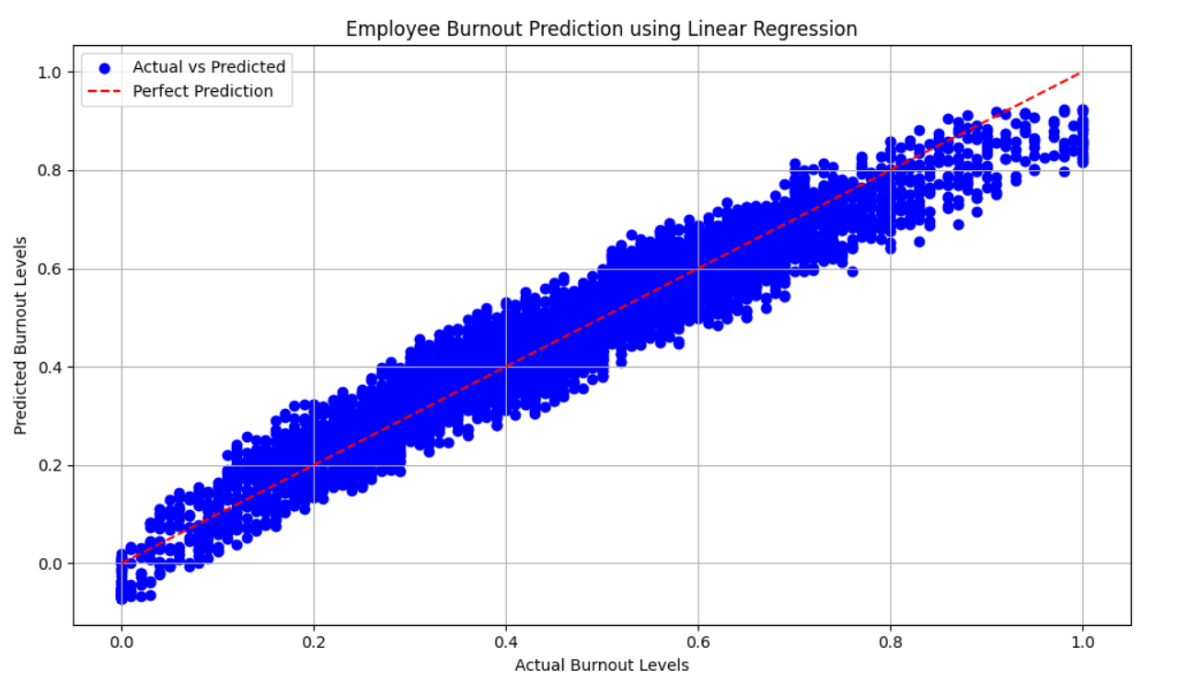
customization of project
Customizing employee burnout prediction using linear regression involves tailoring the model to fit the specific context and needs of the organization or research study.
Selecting Relevant Predictors Identify and include predictors that are most relevant to the organization or context. These could include variables such as workload, job satisfaction, work-life balance, job demands, social support at work, etc. The choice of predictors should be based on theoretical considerations, domain knowledge, and data availability.
Visualization played a crucial role in customizing employee burnout prediction using linear regression by providing insights into the relationships between predictors and the outcome (burnout).

Slide 9
MODELLING
Modelling Process:
Exploratory Data Analysis
Preprocessing
One-Hot-Encoding
Visualization
Modelling Techniques used:
Linear Regression : A relationships between predictors and burnout are expected to be approximately linear and there is no significant multicollinearity, linear regression can be a straightforward choice.
Support Vector Machine(Linear) : A linear Support Vector Machine (SVM) is a type of SVM that uses a linear decision boundary to classify data points into different classes.
Support Vector Machine(RBF) : The RBF (Radial Basis Function) Support Vector Machine (SVM) is a variant of SVM that uses the kernel trick with the RBF kernel to handle non-linear classification tasks.
Random Forest Regression : Random Forest Regression is an ensemble learning technique that uses multiple decision trees to perform regression tasks.

Slide 10
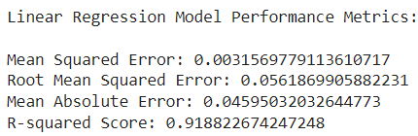
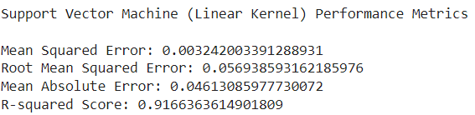
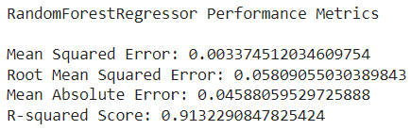
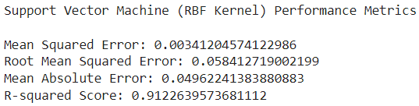
Results
Based on the evaluation metrics, the Linear Regression model appears to be the best model for predicting burnout analysis. So we are choosing this model for deployment
It has the lowest mean squared error, root mean squared error, and mean absolute error, indicating better accuracy and precision in its prediction. Additionally, it has the highest R-Squared score, indicating a good fit to the data and explaining a higher proportion of the variance in the target variable.

Slide 11
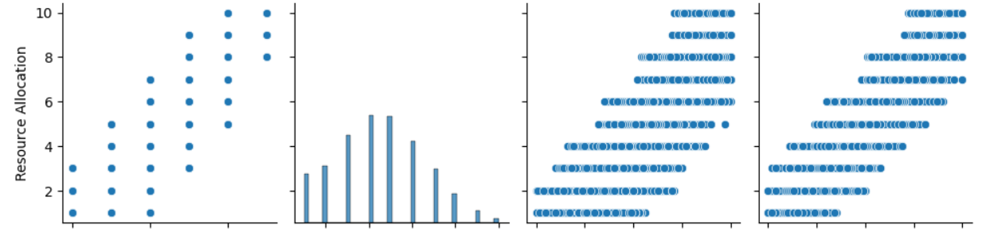
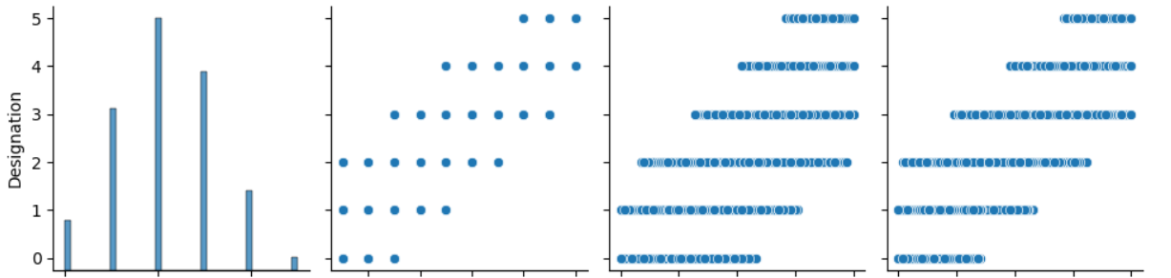
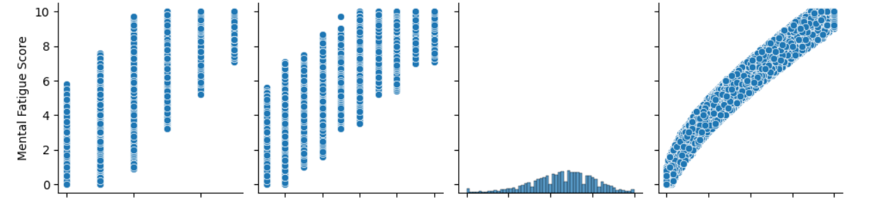
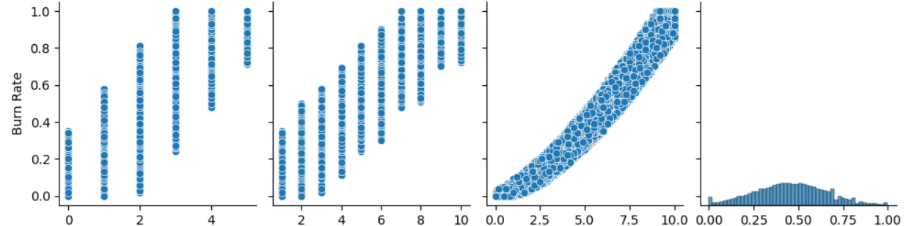
VISUALIZATION

Slide 12
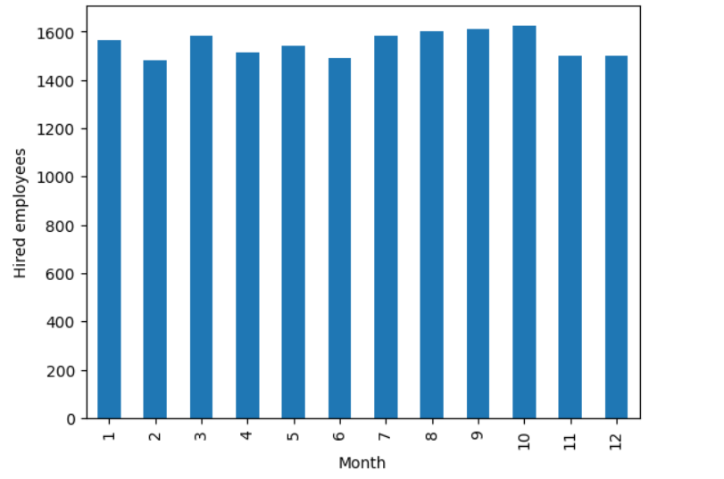
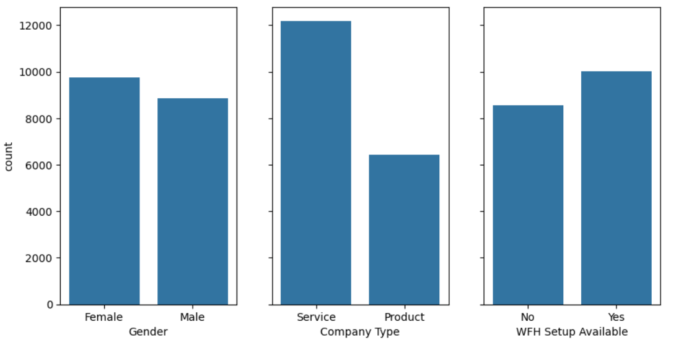
VISUALIZATION

Slide 13
LINKS
GitHub Link (Project Link):
https://github.com/21A91A05E2/AIML-PROJECT
Reference Links:
https://www.javatpoint.com/linear-regression-in-machine-learning

